Slide 1

Marketing and Retail Analysis – Project 1
Automobile parts manufacturing company
Yaresh Vijayasundaram
Post Graduate Program in Data Science and Business Analytics
BATCH: PGPDSBA.O.SEP22.A

Slide 2

CONTENT
Agenda & Executive Summary of the data
Exploratory Analysis and Inferences
Customer Segmentation using RFM analysis
Inferences from RFM Analysis and identified segments
Recommendations

Slide 3

01. Agenda & Executive Summary of the data
Problem Statement
About Data (Info, Shape, Summary Stats, your assumptions about data)
Assumption on the data

Slide 4

Problem Statement:
An automobile parts manufacturing company has collected data on transactions for 3 years. They do not have any in-house data science team; thus, they have hired you as their consultant. Your job is to use your data science skills to find the underlying buying patterns of the customers, provide the company with suitable insights about their customers, and recommend customized marketing strategies for different segments of customers.

Slide 5

Executive Summary of the data:
Objective: The objective of this analysis was to identify the underlying buying patterns of customers, provide insightful information about customer behaviour, and recommend customized marketing strategies for different customer segments.
The dataset consists of 2,747 transactions made by customers of an automobile parts manufacturing company.
The dataset consists of 20 columns, including 2 float, 6 integer, and 12 object data types, providing a diverse range of information about the transactions and customers.
The dataset is free from duplicate entries.
Customers on average ordered 35 items per transaction, with a minimum of 6 and a maximum of 97.
The average number of days since the last order is 1,757.09, with a minimum of 42 days and a maximum of 3,562 days.
The average Manufacturer's Suggested Retail Price (MSRP) of the products is $100.69, with a standard deviation of $40.11.
RFM (Recency, Frequency, Monetary) analysis is a powerful technique used to analyse customer behaviour based on their transaction history. By evaluating the recency of their last purchase, the frequency of their transactions, and the monetary value of their purchases, RFM analysis helps businesses identify and segment their customers into different groups to tailor marketing strategies and optimize customer retention efforts.

Slide 6

Assumption on the data
The dataset contains information about orders placed by customers. Each order is identified by a unique ORDERNUMBER.
The dataset contains information about customers' transactions and their associated details, such as the number of items purchased, days since the last order, and the MSRP of the products. This implies that the dataset includes transactional data related to customer purchases.
The dataset does not contain duplicate entries. This means that each transaction entry is unique, and there are no repeated records for the same transaction or customer.

Slide 7

02. Exploratory Analysis
and Inferences

Slide 8
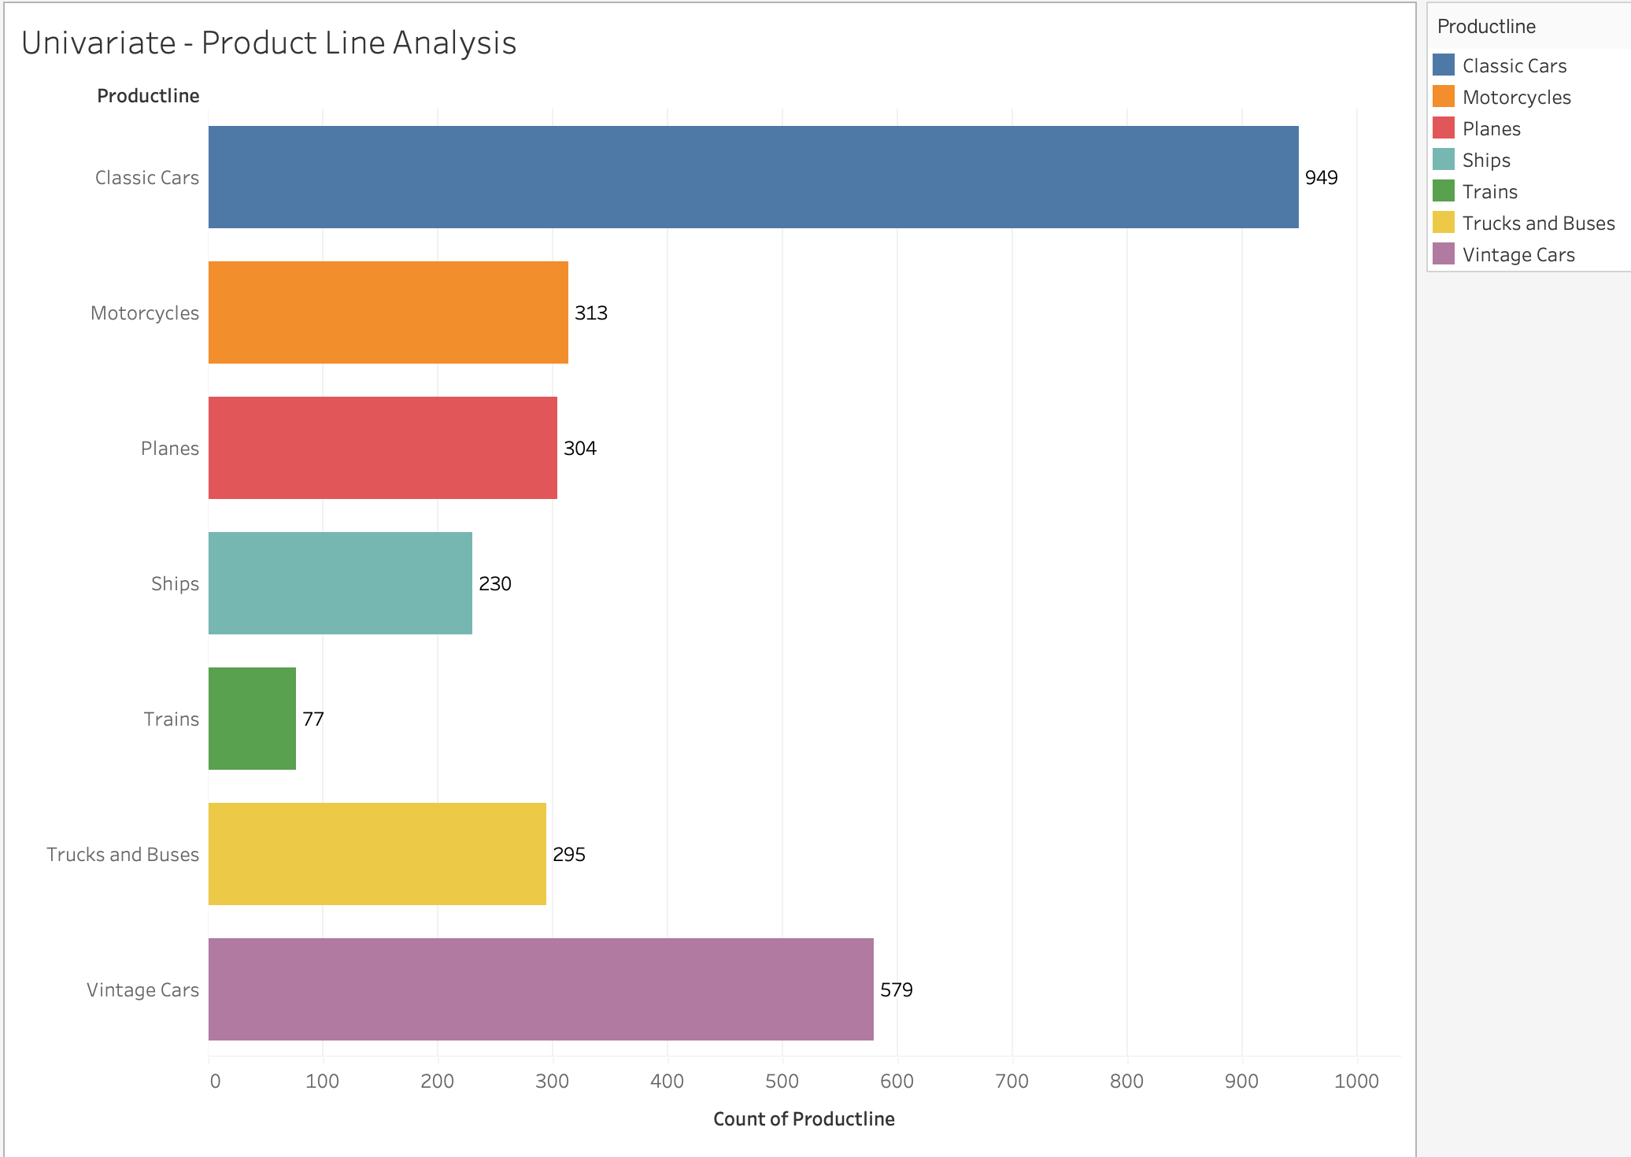
Product Line Analysis
Inferences :
Classic cars and vintage cars are the most popular product lines, indicating a strong demand for these vehicle models.
Ships, trucks, buses, and trains have relatively lower counts, suggesting a niche market or specialized customer base for these product lines.
Notes:
Product Line Analysis – Univariate

Slide 9
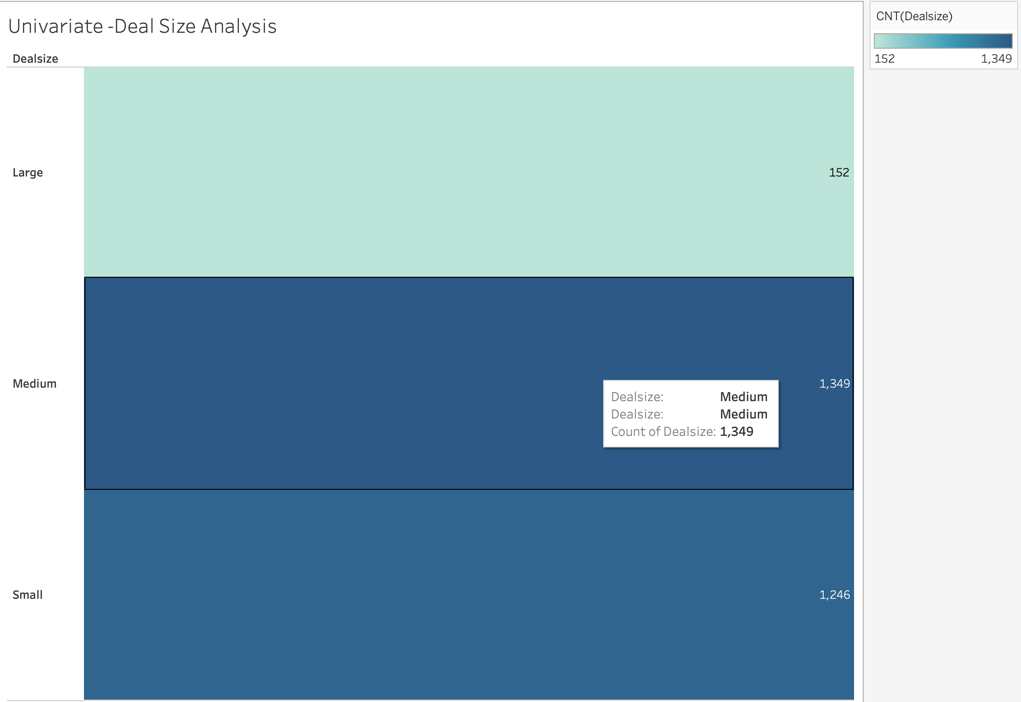
Deal Size Analysis
Inferences :
The majority of the deals fall into the small and medium categories, with counts of 1,246 and 1,349, respectively. This indicates that the company primarily engages in transactions of moderate to smaller deal sizes.
Notes:
Deal size Analysis – Univariate

Slide 10
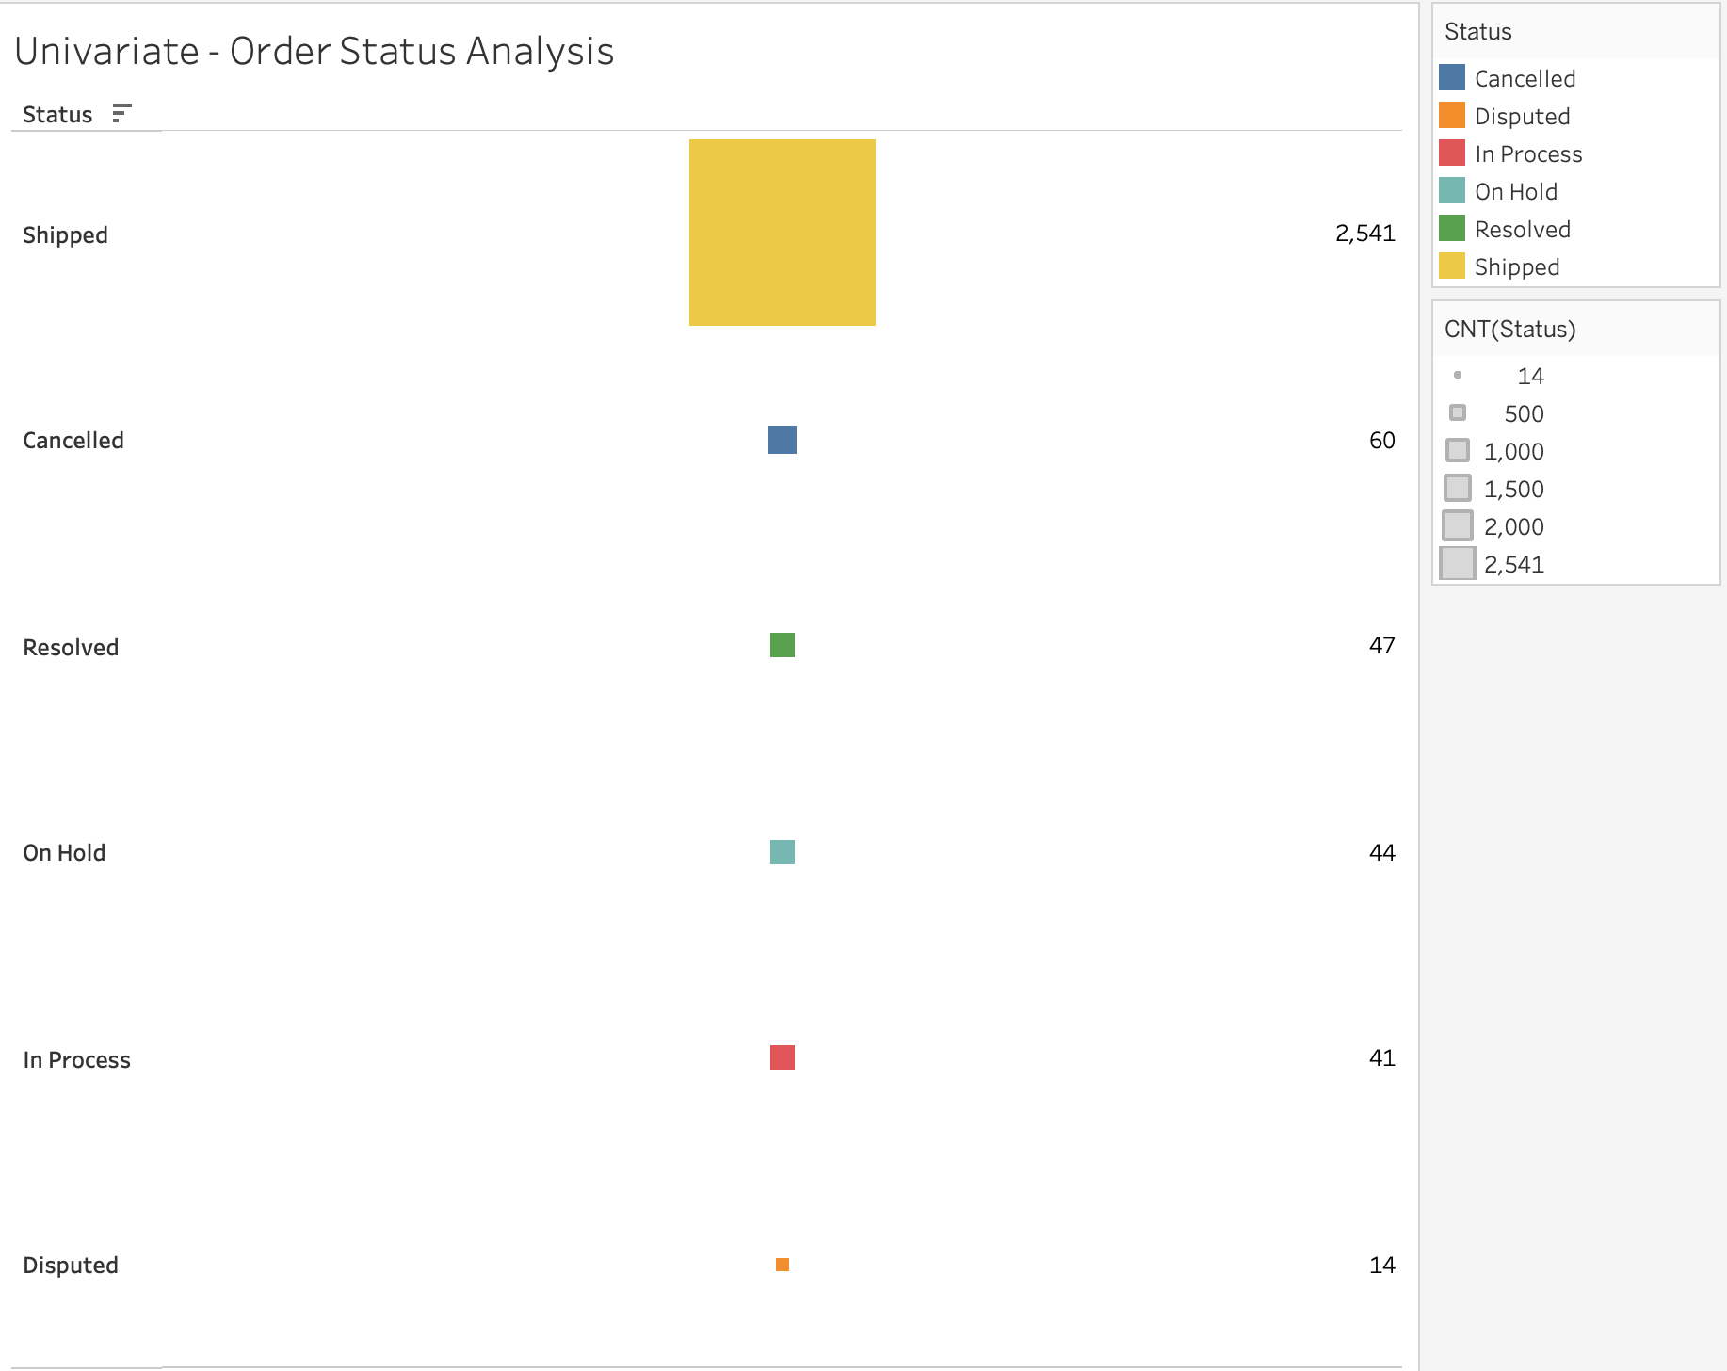
Order Status Analysis
Inferences :
The significant count of 2,541 successfully shipped orders reflects the company's outstanding order fulfilment capabilities and commitment to delivering orders promptly.
Notes:
Order status Analysis – Univariate

Slide 11
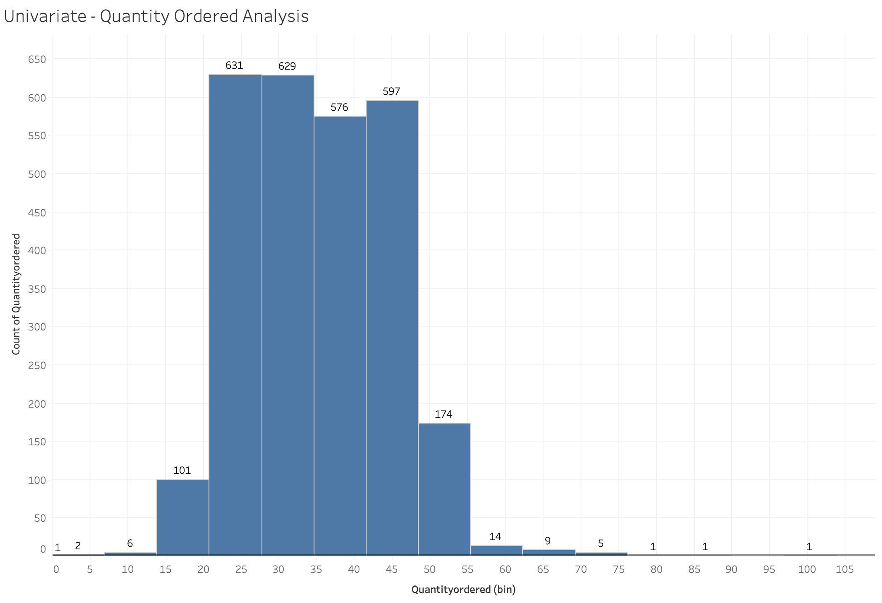
Quantity Ordered Analysis
Inferences :
The bins with quality orders of 21, 28, 35, and 42 have the highest counts, indicating their popularity among customers. With counts ranging from 576 to 631, these quantities meet the demands of a significant portion of customers
Notes:
Univariate - Quantity Ordered Analysis

Slide 12
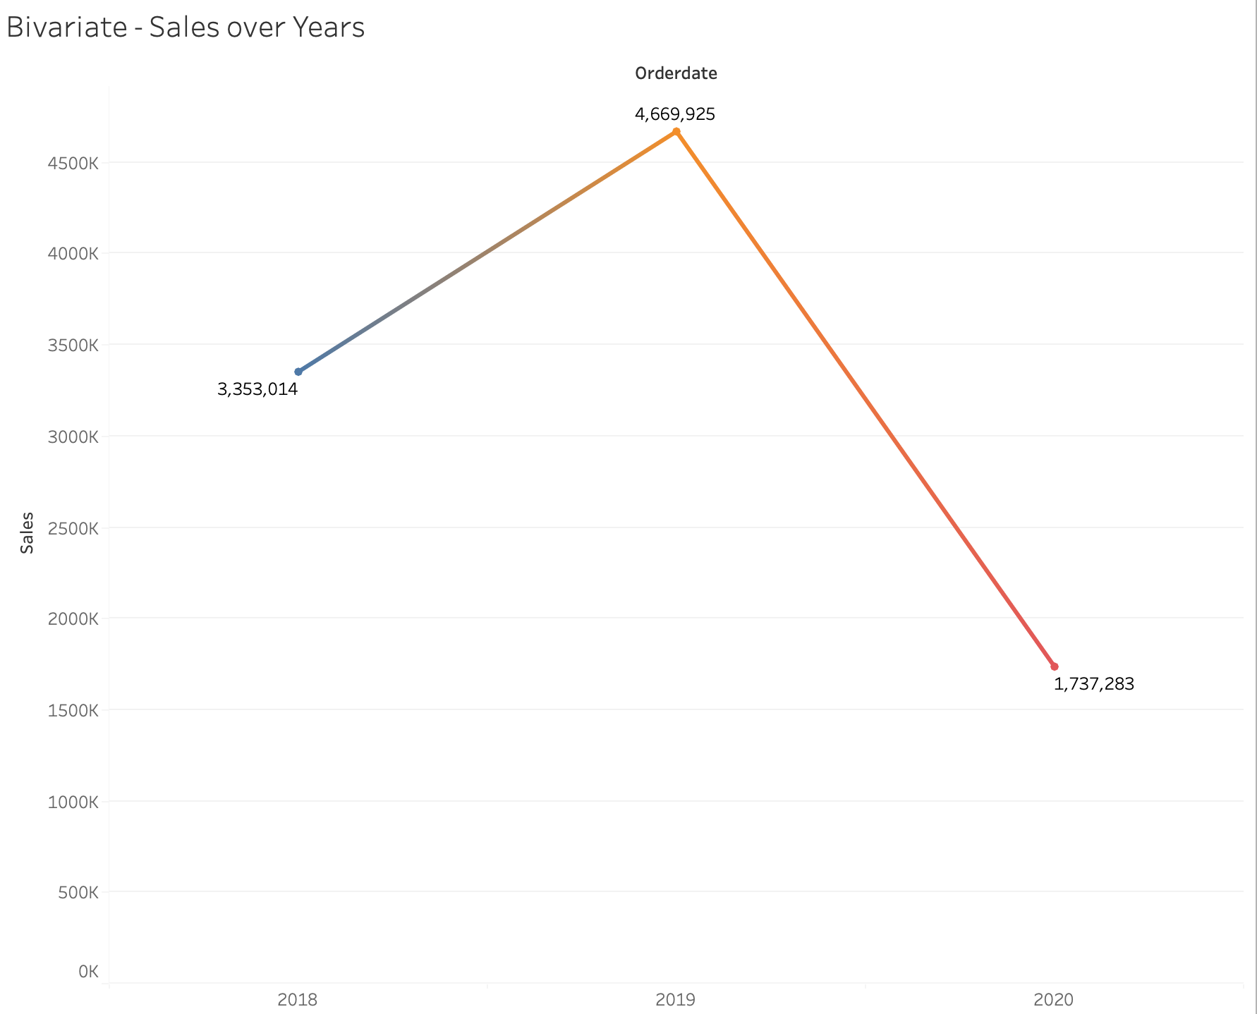
Inference: * Sales showed a positive trend and grew significantly from 2018 (3,353,014) to 2019 (4,669,925), suggesting that the business performed well and experienced an increase in customer demand. * However, since we only have sales data until May for 2020 (1,737,283), it is difficult to make conclusive statements about the entire year.
Sales over Years
Notes:
Bi-variate – Sales over years.

Slide 13
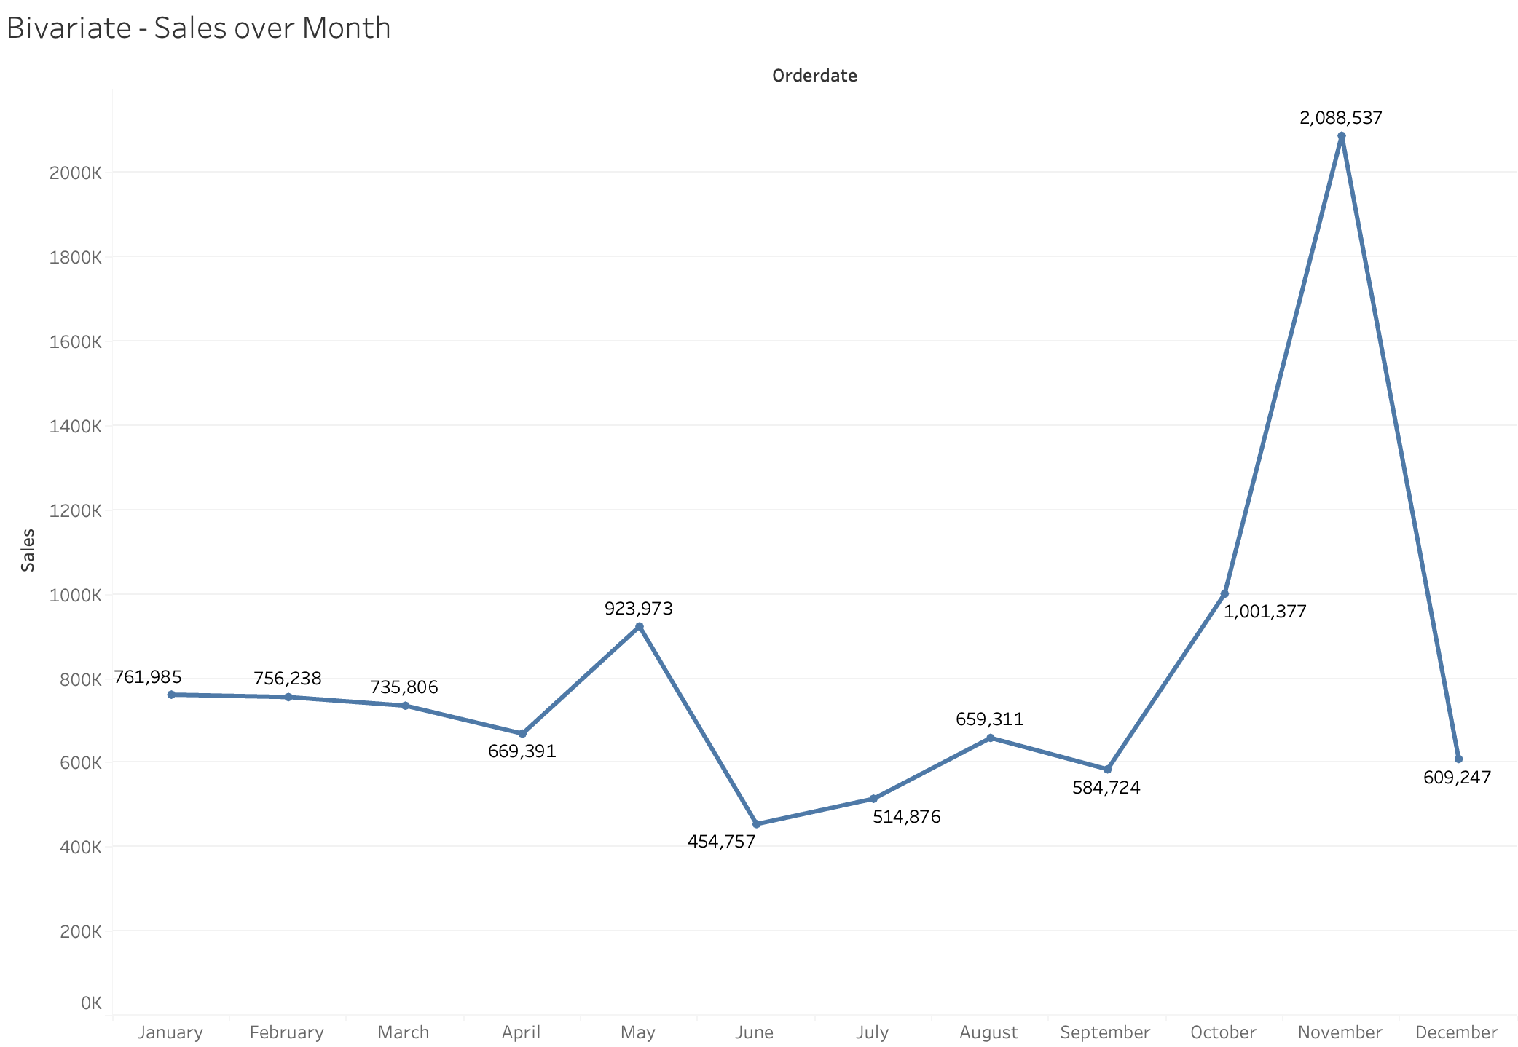
Inference: * The sales data exhibits fluctuations throughout the year, with peak sales recorded in November (2,088,537) and October (1,001,377), indicating heightened customer activity likely influenced by seasonal factor. * In contrast, June records the lowest sales (454,757), suggesting a potential decrease in customer demand during that period.
Sales over Month
Notes:
Bi-variate – Sales over months.

Slide 14
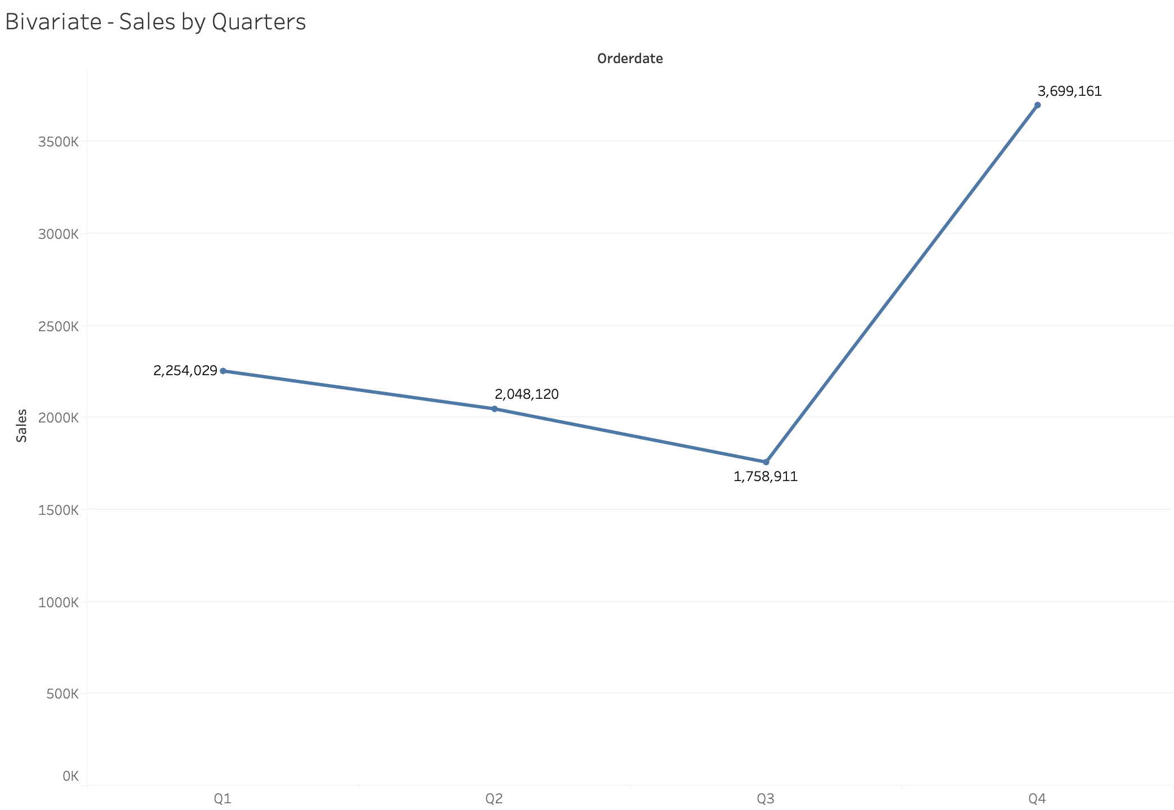
Inference: * The quarterly sales data over the three-year period reveals a consistent pattern of higher sales in Q4 (3,699,161) compared to other quarters. This indicates a potential seasonal trend where the end of the year witnesses increased customer spending. * Q1 (2,254,029) and Q2 (2,048,120) show relatively stable sales figures, while Q3 (1,758,911) records the lowest sales among the quarters.
Sales by Quarters
Notes:
Bi-variate – Quarterly sales.

Slide 15
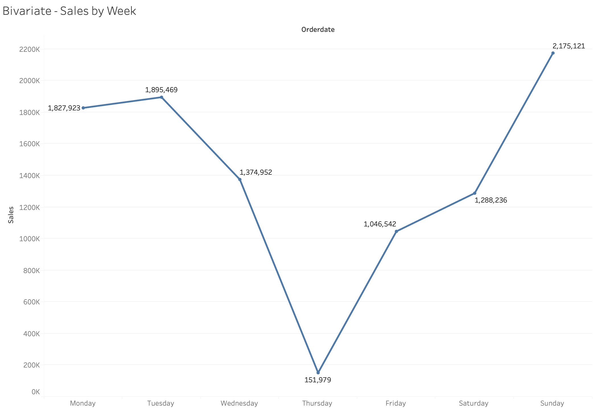
Inference: * Sundays have consistently shown the highest sales (2,175,121) over the three-year period, indicating that customers tend to be more active and likely prefer shopping on weekends. * Wednesdays, on the other hand, have the lowest sales (1,374,952) among the weekdays, suggesting that customers may be less engaged or influenced by factors that affect their buying behaviour on this specific day.
Sales by Week
Notes:
Bi-variate – Sales over weekdays.

Slide 16
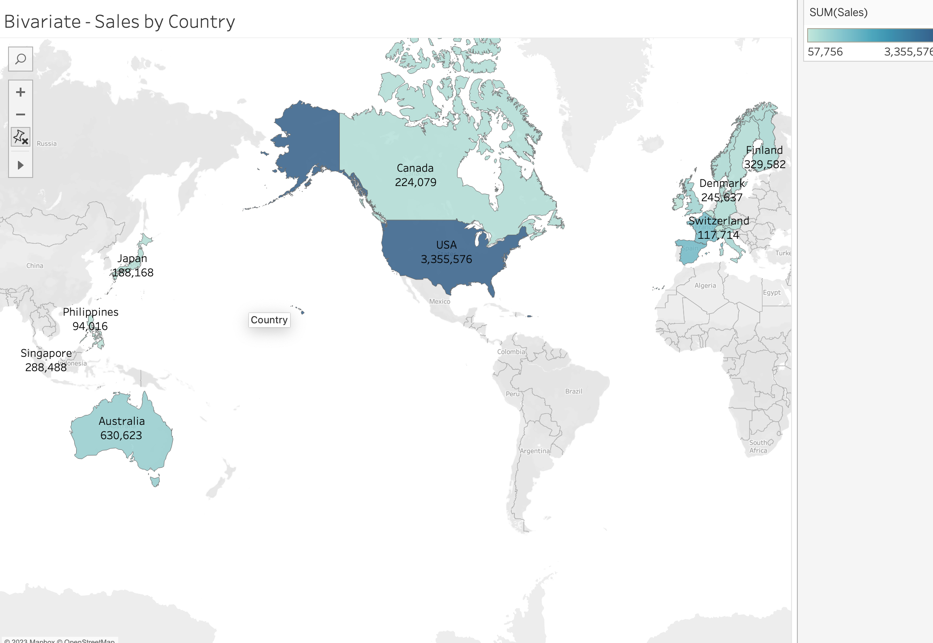
Inference: * The sales data by country indicates that the USA (3,355,576) has significantly higher sales compared to other countries, suggesting a strong market presence and potentially a larger customer base. * Canada (224,079), Singapore (288,488), Denmark (245,637), and Finland (329,582) also demonstrate notable sales figures, indicating significant market opportunities and customer demand in these respective countries
Sales by Country
Notes:
Bi-variate – Sales by country.

Slide 17
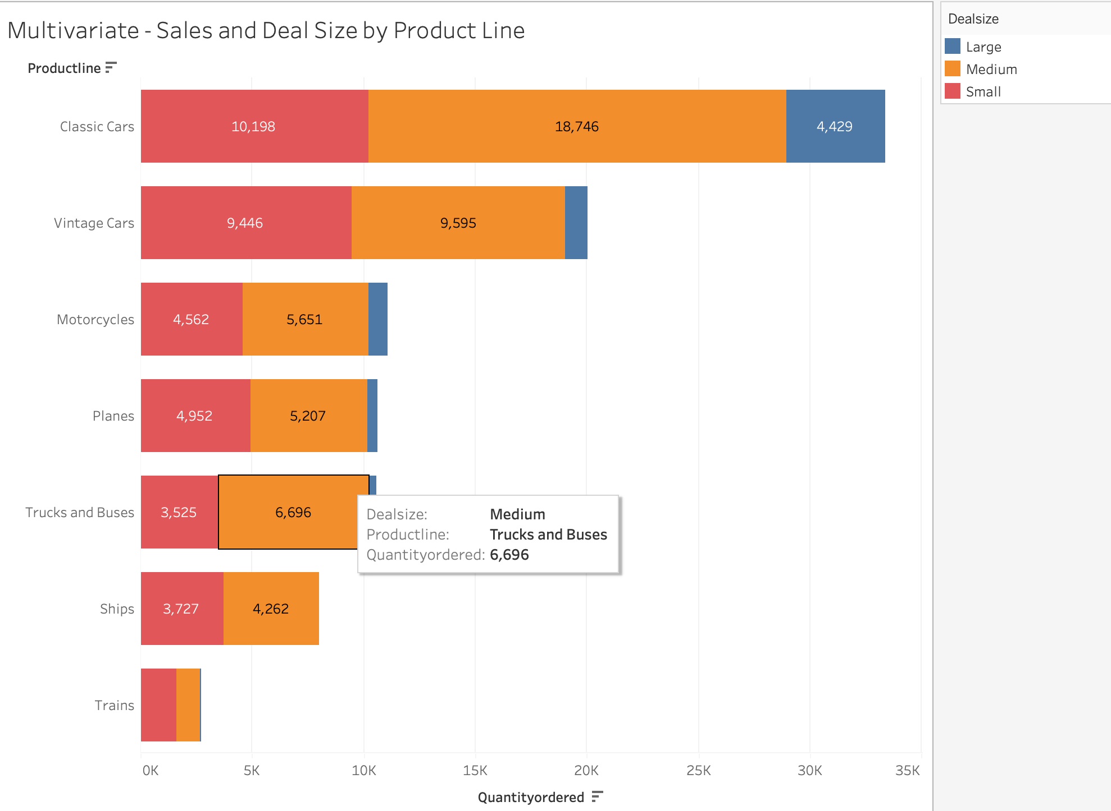

Sales and Deal size by Product line
Inference:
The graph reveals that Classic Cars and Vintage Cars are the most frequently ordered product lines, followed by Motorcycles, Planes, Trucks & Buses, and Ships. In contrast, Trains had the lowest number of orders. Interestingly, across all product lines, most orders fell into the medium and small deal size categories. Higher deal sizes were relatively less common among the popular product lines.
Notes:
Multivariate - Sales and Deal Size by Product Line

Slide 18
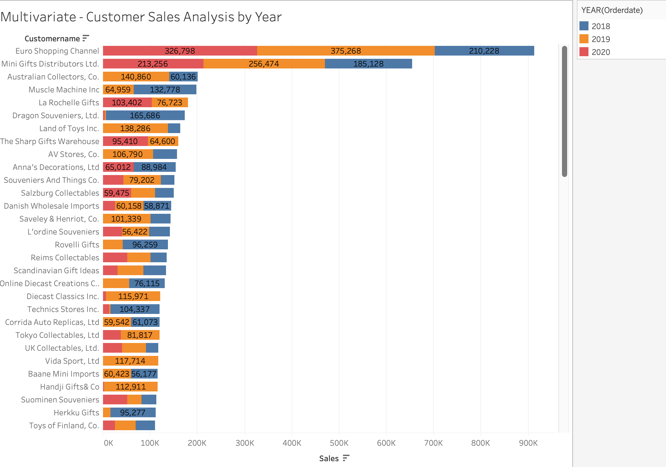

Customer Sales Analysis by Year (2018-2020):
Euro Shopping Channel:
Highest sales across all three years.
Maintained consistent sales performance.
Mini Gift Distributor Ltd:
Second-highest sales.
Demonstrated steady sales growth over the years.
Australian Collectors Co:
Ranked third in sales.
No sales recorded in 2020.
Muscle Machine Inc:
Fourth in terms of sales.
No sales recorded in 2020.
La Rochelle Gifts:
Joined as a new company in 2019.
Showed promising sales in the year of establishment.
Notes:
Multivariate - Customer Sales Analysis by Year

Slide 19

Summary:
Product Line Analysis: Classic cars and vintage cars are the most popular product lines, indicating a strong demand for these vehicle models. Conversely, ships, trucks, buses, and trains have relatively lower counts, suggesting a niche market or specialized customer base for these product lines.
Deal Size Analysis: The majority of the deals fall into the small and medium categories, with counts of 1,246 and 1,349, respectively. This indicates that the company primarily engages in transactions of moderate to smaller deal sizes.
Order Status Analysis: The significant count of 2,541 successfully shipped orders reflects the company's outstanding order fulfilment capabilities and commitment to delivering orders promptly.
Quality Ordered Analysis: The bins with quality orders of 21, 28, 35, and 42 have the highest counts, indicating their popularity among customers. With counts ranging from 576 to 631, these quantities meet the demands of a significant portion of customers.
Sales Analysis: Sales showed a positive trend and grew significantly from 2018 (3,353,014) to 2019 (4,669,925), suggesting that the business performed well and experienced an increase in customer demand. However, since we only have sales data until May for 2020 (1,737,283), it is difficult to make conclusive statements about the entire year.

Slide 20

03. Customer Segmentation using RFM analysis
(4 segments)
What is RFM?
What all parameters used, and assumptions made?
Showcase the KNIME workflow image.
What results are there in the output table head?

Slide 21

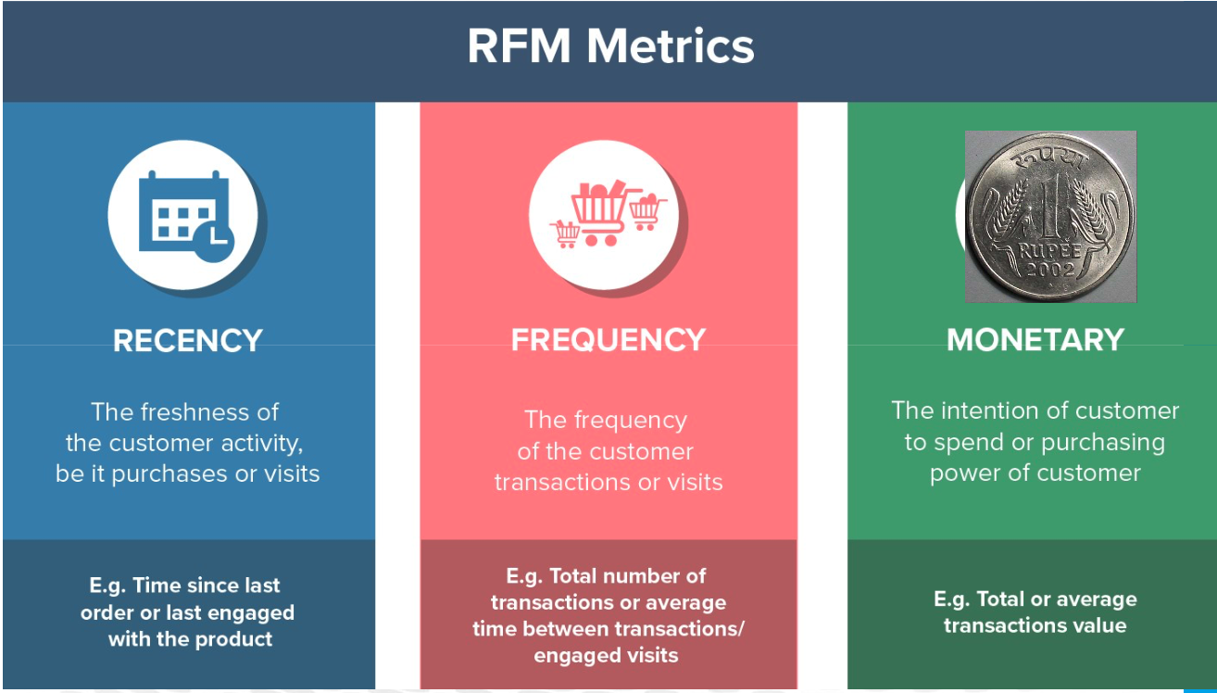
RFM
RFM analysis is a customer segmentation technique commonly used in marketing and retail to analyse and categorize customers based on their purchasing behaviour. RFM stands for Recency, Frequency, and Monetary Value, which are three key metrics used to evaluate customer engagement and profitability.

Slide 22
PARAMETERS
Monetary: Calculated by multiplying the price each with the quantity ordered. It represents the monetary value or revenue generated by each customer.
Recency: Determined by subtracting the order date from a fixed reference date, such as 01-06-2020. It represents how recently a customer made a purchase.
Frequency: Calculated as the count of customer names. It represents how often a customer has made purchases.
Auto-binning: Customers are segmented into four categories based on their RFM scores - High, Moderate, Low, and Very Low. This segmentation helps in categorizing customers based on their value and behaviour.
These parameters are utilized in RFM analysis to evaluate customer behaviour, identify customer segments, and make data-driven marketing and sales decisions.
ASSUMPTION:
Higher Monetary value indicates a higher spending customer: The assumption is that customers who generate higher monetary value through their purchases are likely to be more valuable and potentially more profitable for the business.
Recent purchases are more indicative of customer engagement: The assumption is that customers who have made purchases more recently are likely to be more engaged with the company and its offerings. They may have higher potential for repeat purchases or upselling/cross-selling opportunities.
Higher Frequency of purchases reflects customer loyalty: The assumption is that customers who make purchases more frequently are more loyal to the company. They may have a stronger connection to the brand, higher customer satisfaction, and a higher likelihood of recommending the company to others.

Slide 23
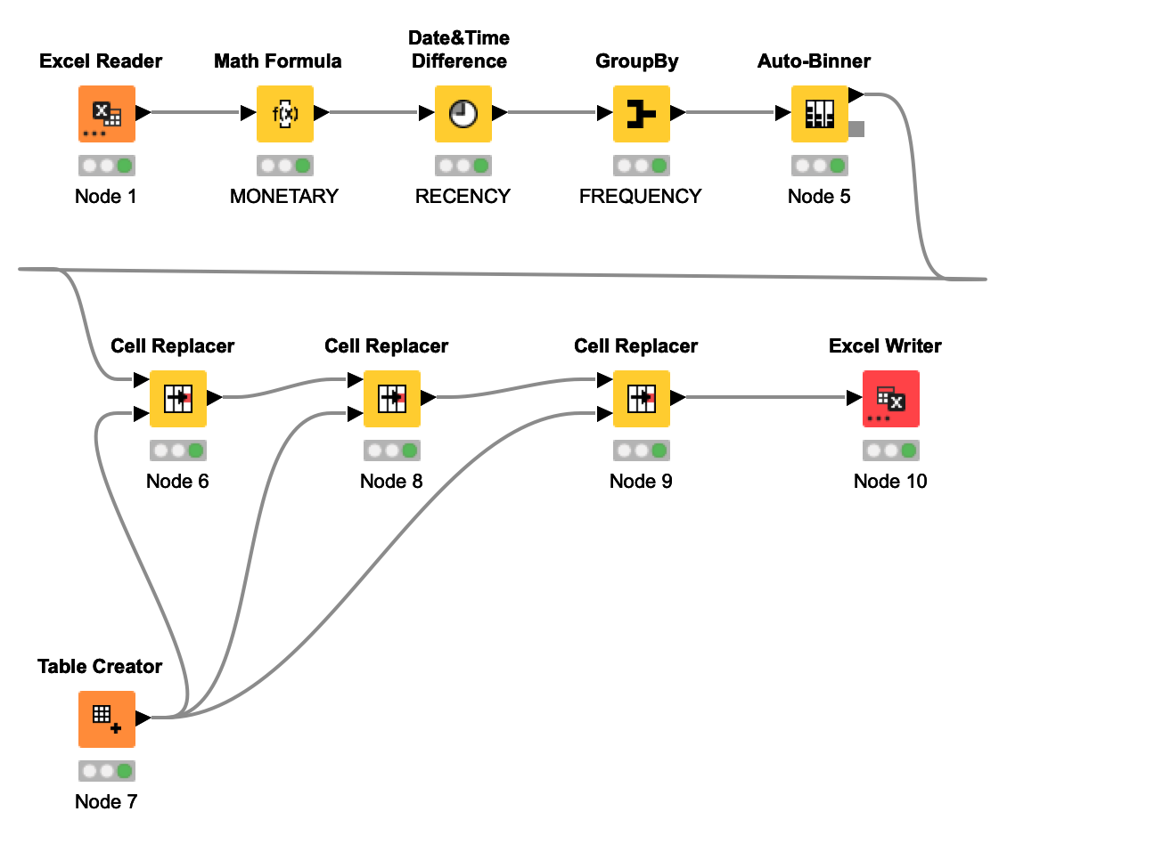

KNIME WORKFLOW
Tool Used

Slide 24
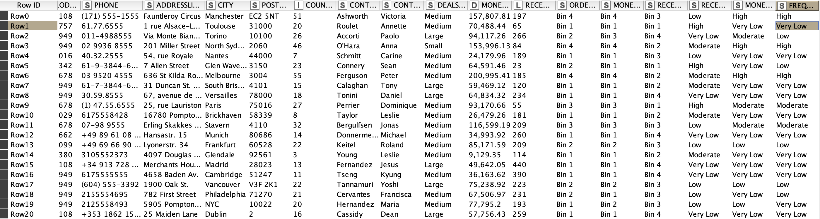
Output table head

Slide 25

04. Inferences from RFM Analysis and identified segments:
Who are your best customers?
Which customers are on the verge of churning?
Who are your lost customers?
Who are your loyal customers?

Slide 26
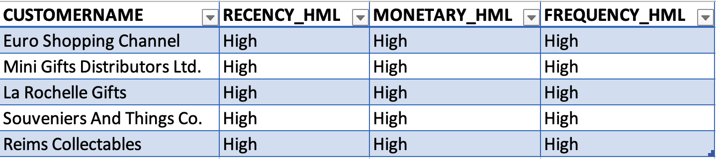
TOP 5 Best Customers
The top 5 best customers are determined by calculating the RFM score, which is the sum of scores for Monetary, Recency, and Frequency. Higher RFM scores indicate more valuable customers.

Slide 27
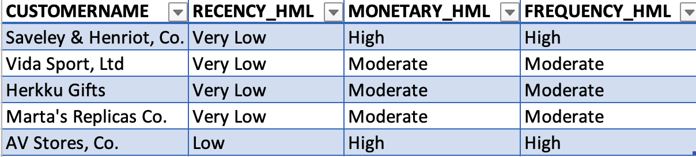
Customers at Risk of Churning: Identifying Potential Churners
The customers with very low to low recency, high to moderate monetary value, and high to moderate purchase frequency are at an increased risk of churning.

Slide 28
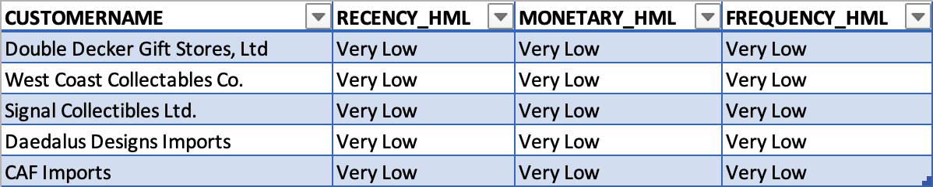
Top 5 Lost customer
Customers with low frequency of purchases, indicating reduced engagement.
Customers with low recency, implying prolonged inactivity.
Customers with low monetary value, suggesting decreased spending.

Slide 29
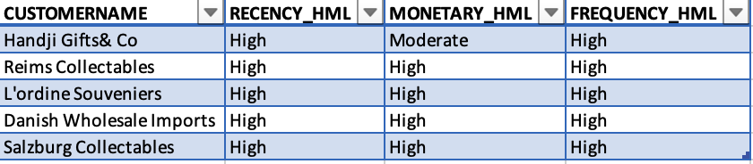
Top 5 Loyal Customer
Loyal customer refers to customers who are consistent and repeat purchases over time. They may not necessarily have the highest monetary value, but they demonstrate a strong commitment to the brand by repeatedly choosing to do business with the company.

Slide 30

05. RECOMMENDATIONS:
Customer Retention Strategies: Engage and retain customers who are at risk of churning. Offer personalized incentives, loyalty programs, or exclusive promotions to encourage their continued loyalty
Continuous Monitoring and Analysis: Regularly monitor customer behavior, sales trends, and key performance indicators to identify changing patterns and proactively address any potential issues.
Upselling and Cross-Selling Opportunities: Identify opportunities to upsell and cross-sell to existing customers, especially those with a high monetary value. Recommend relevant products or services based on their purchase history to increase their average order value and enhance customer loyalty.

Slide 31


